Slide 1


Sale Forecasting

Slide 2
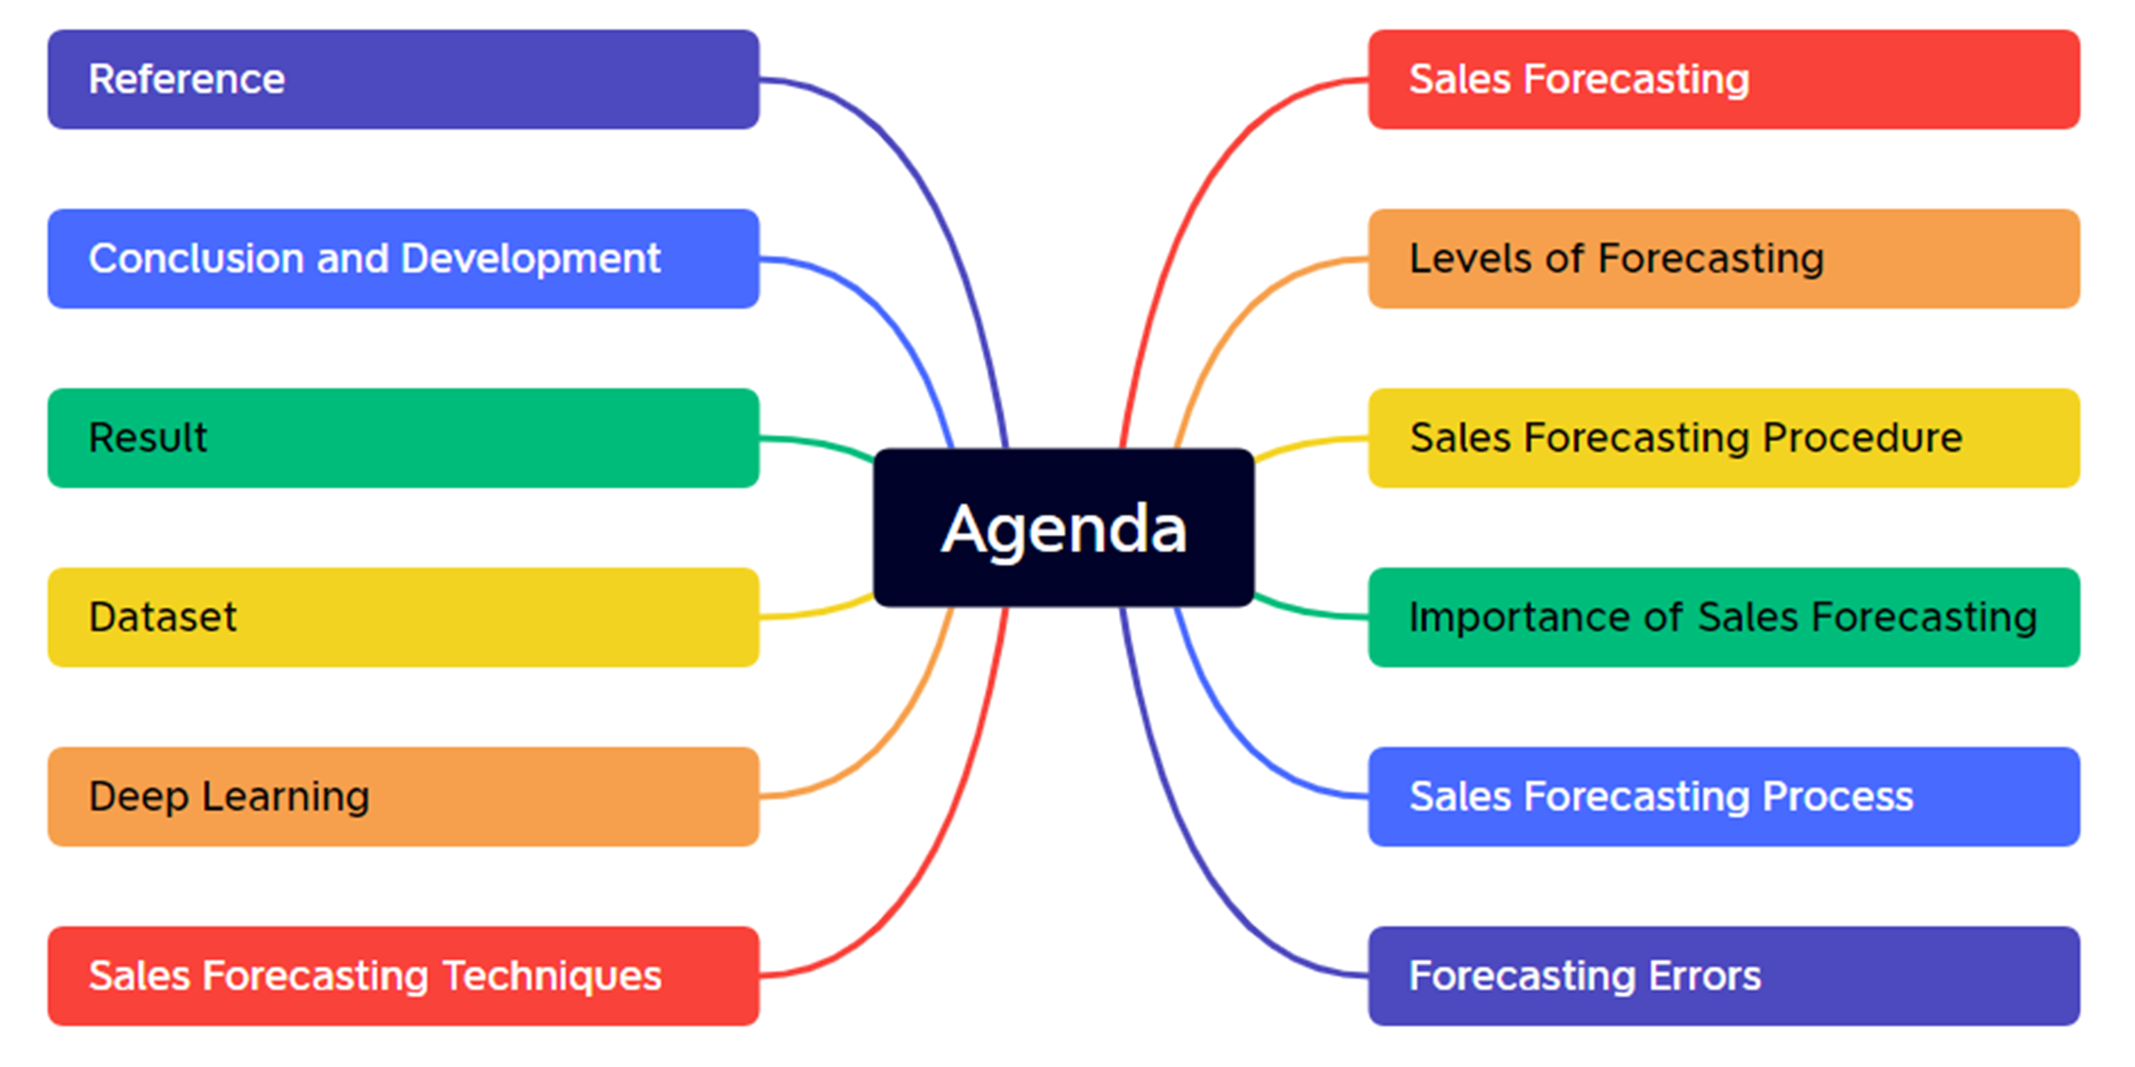

Slide 3

Forecast
Process of making predictions about future events or trends based on past and current data
Notes:
Forecasting is the process of making predictions or estimates about future events or outcomes based on historical data, patterns, and trends. It is widely used in various fields, including economics, finance, business, weather, and demand planning.

Slide 4
Sale Forecasting
Process of estimating future sales revenue based on historical sales data, market trends, and other relevant factors
Notes:
Sales forecasting is a specific type of forecasting that focuses on predicting future sales volumes, revenues, or demand for a product or service. It plays a crucial role in sales and operations planning, budgeting, inventory management, and overall business strategy.

Slide 5
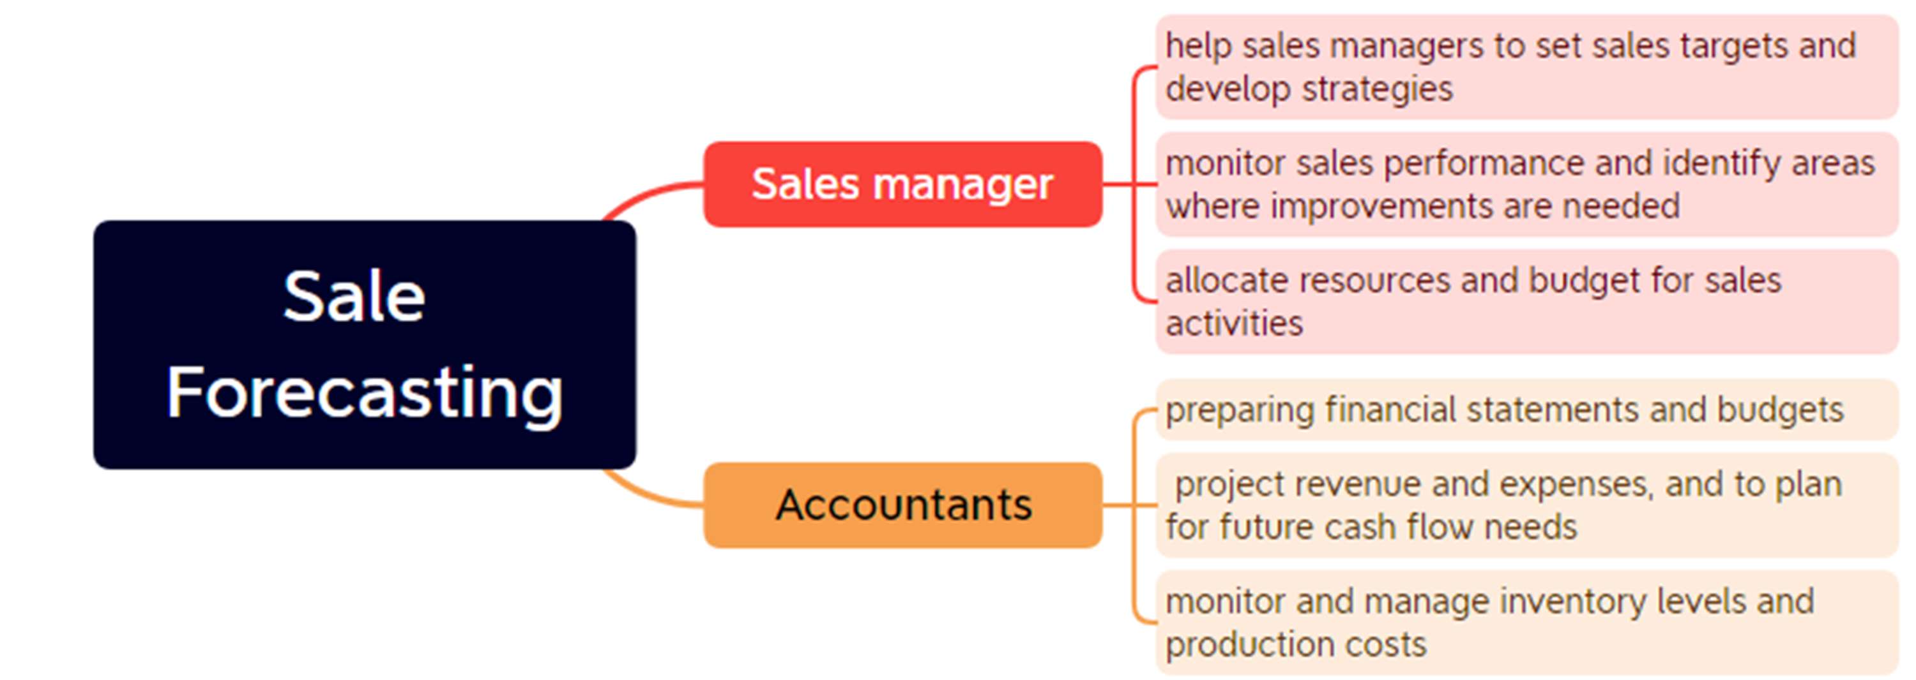

Slide 6
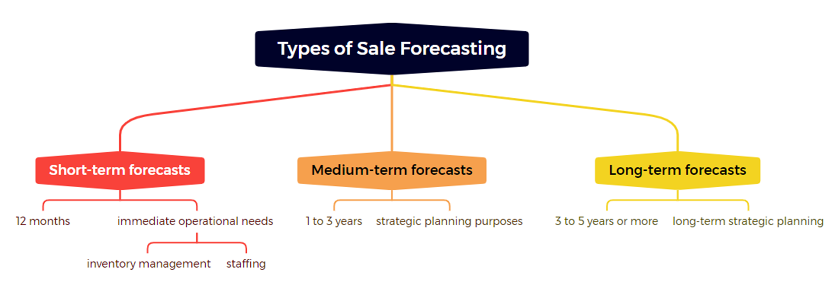

Slide 7
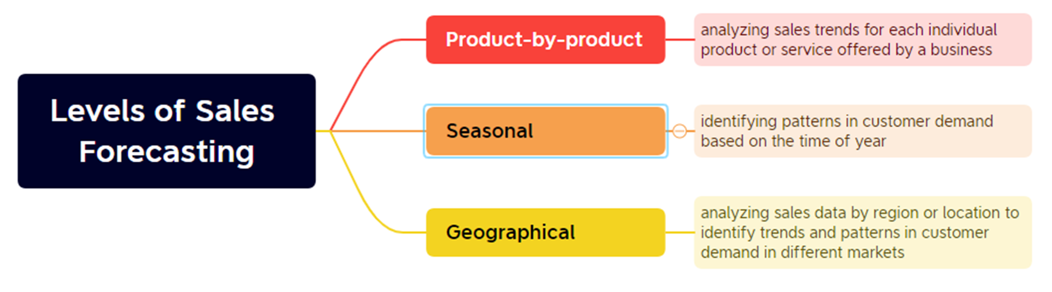

Slide 8
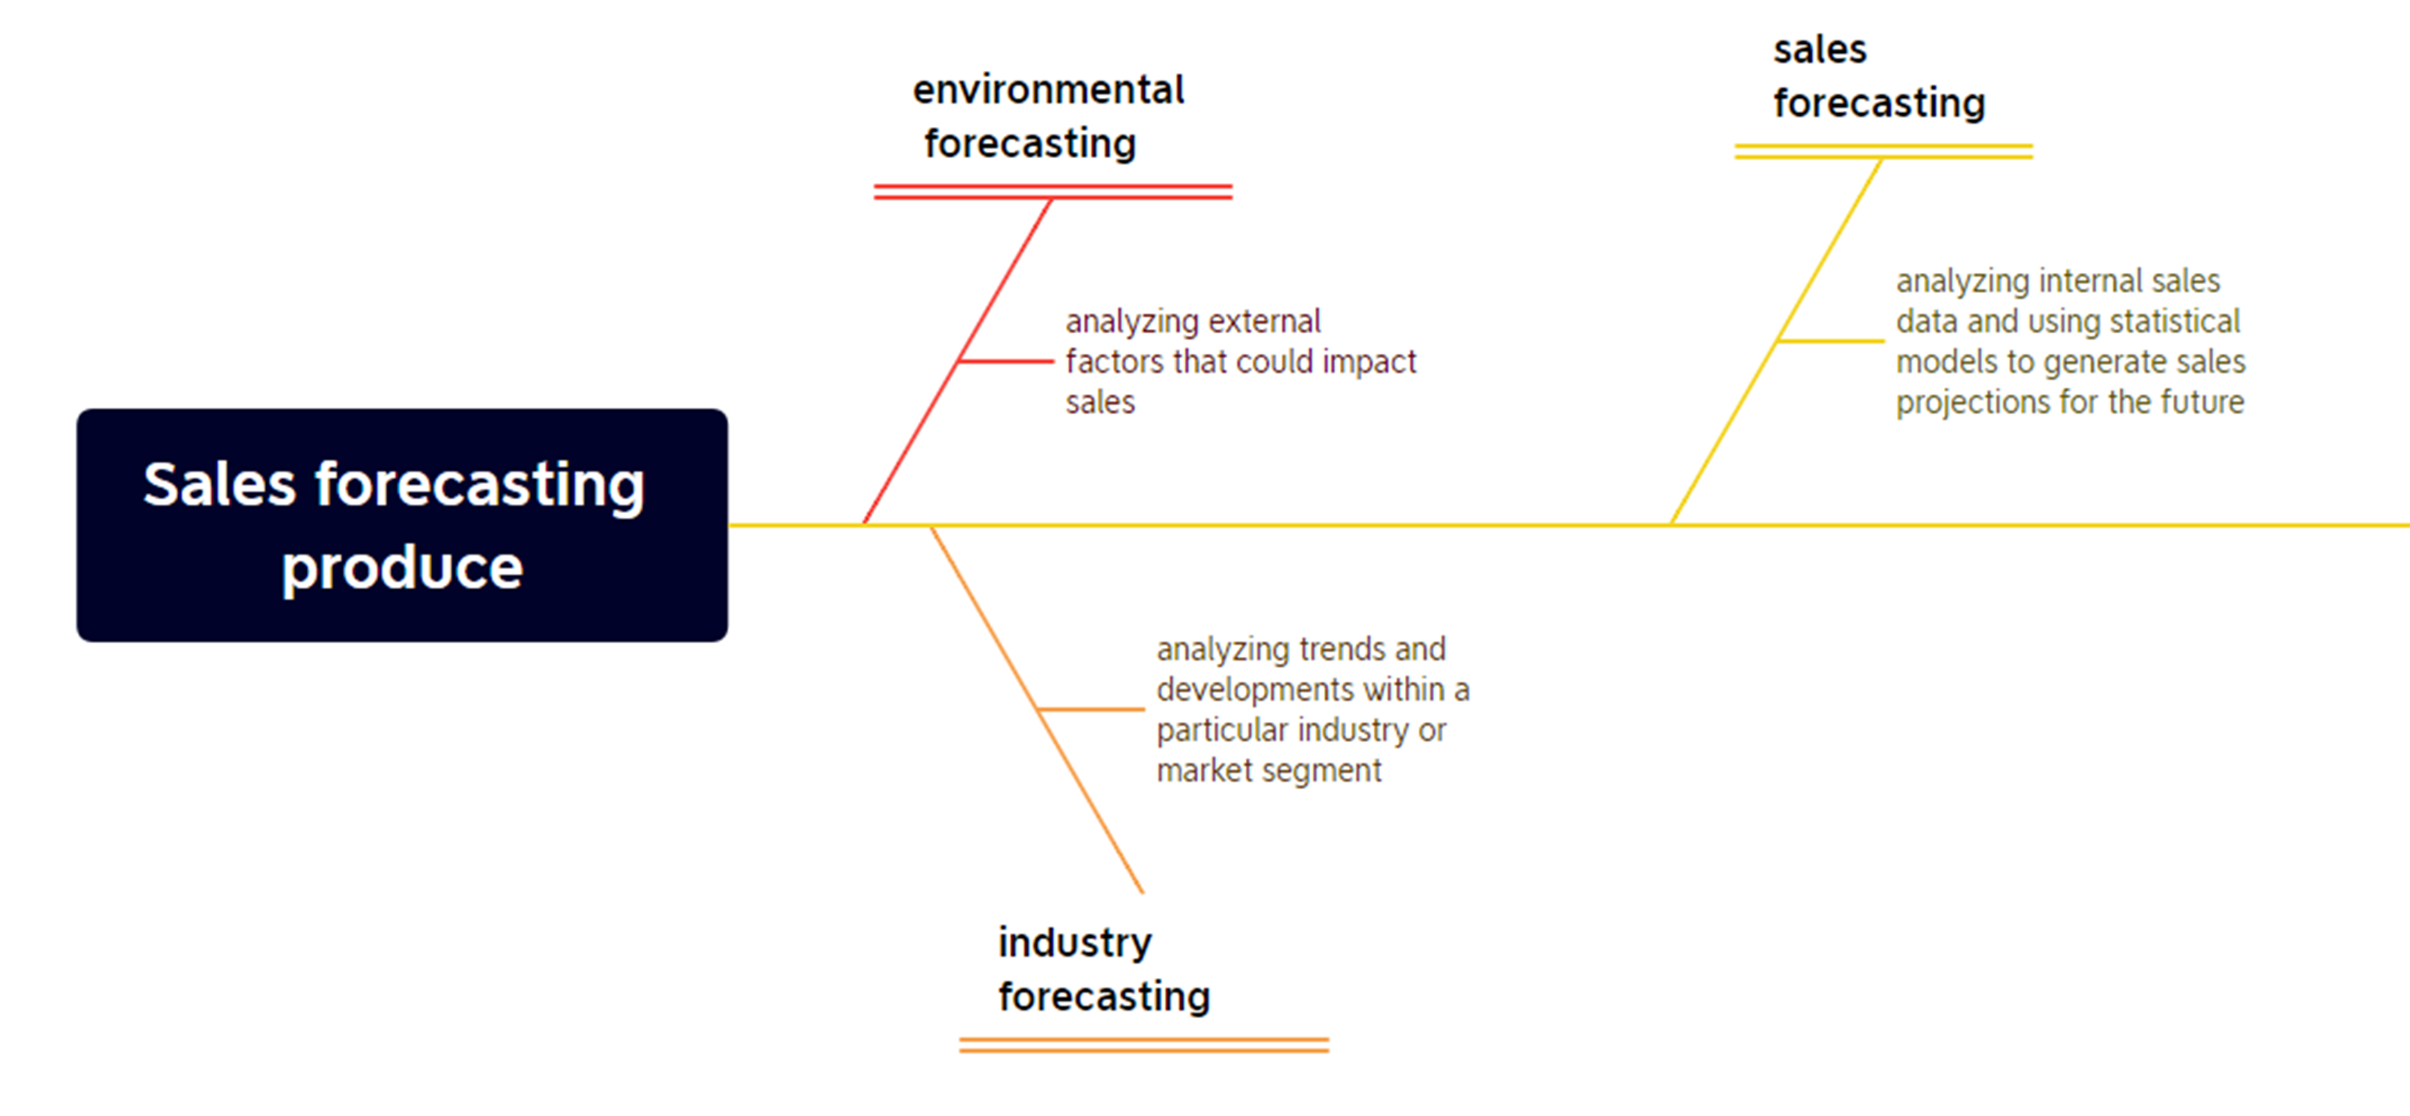

Slide 9
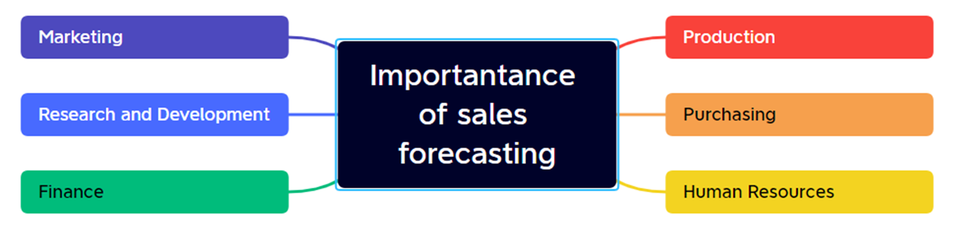

Slide 10
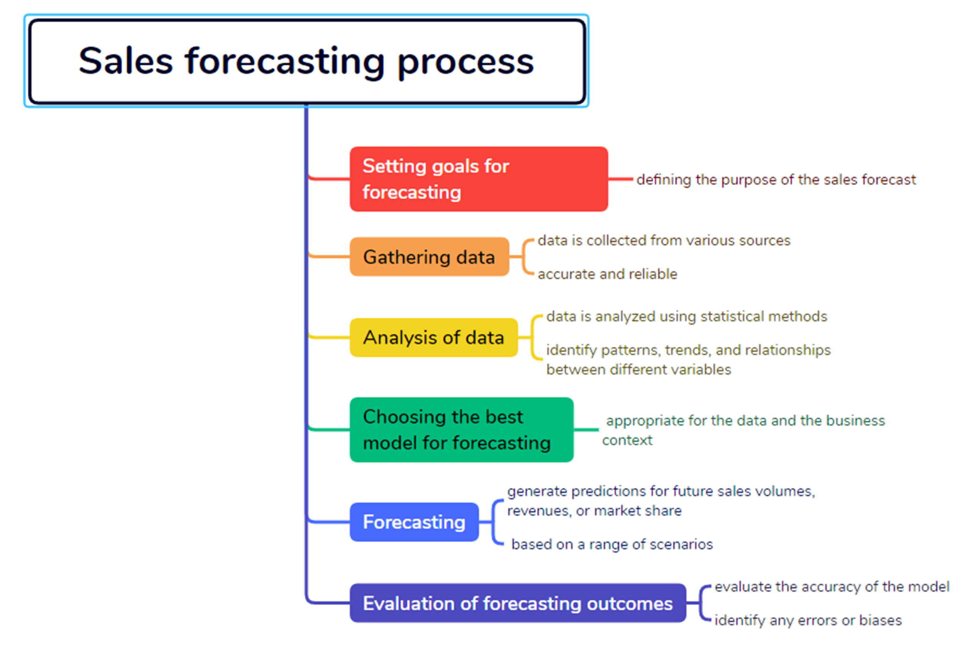

Slide 11
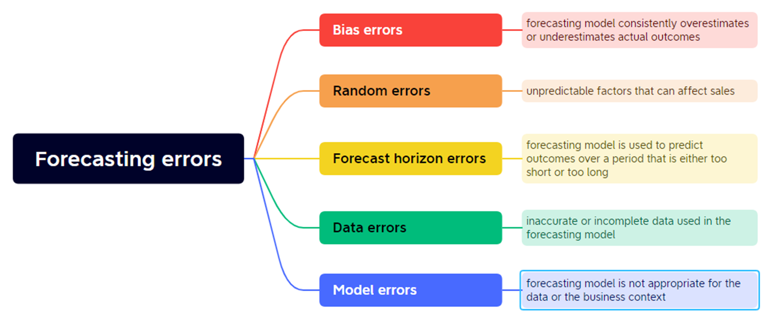

Slide 12
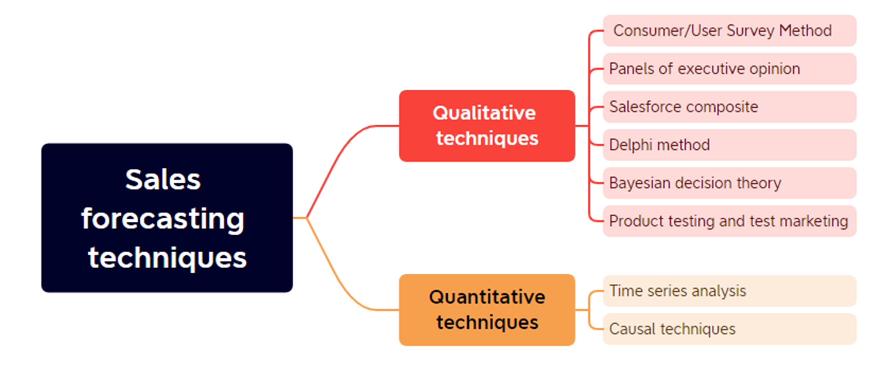

Slide 13
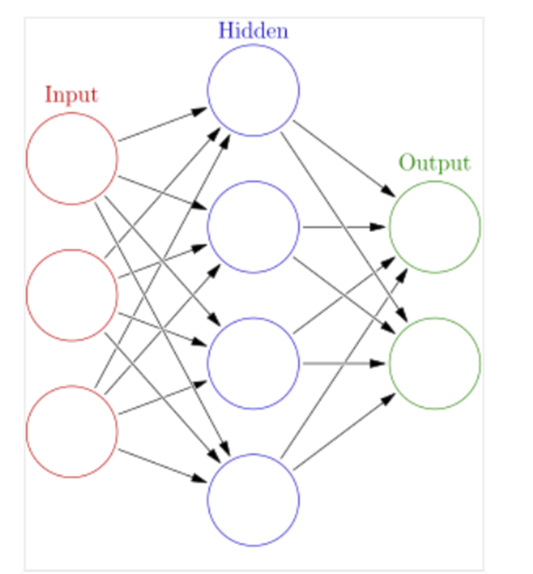
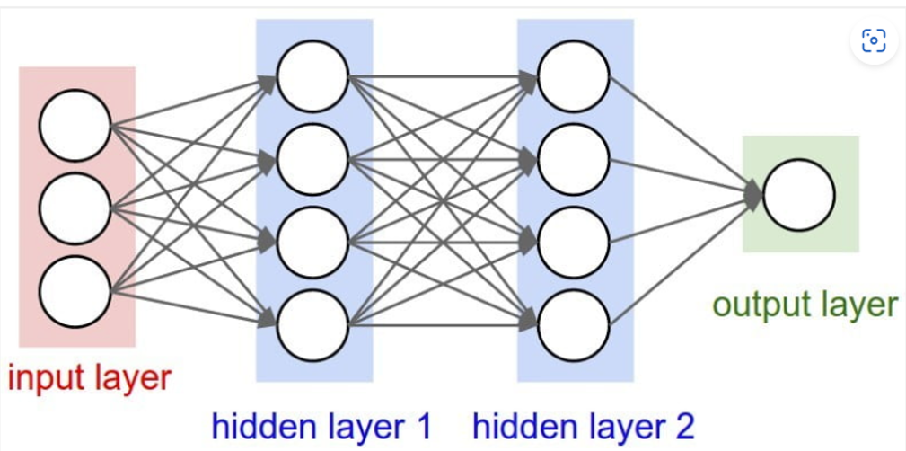
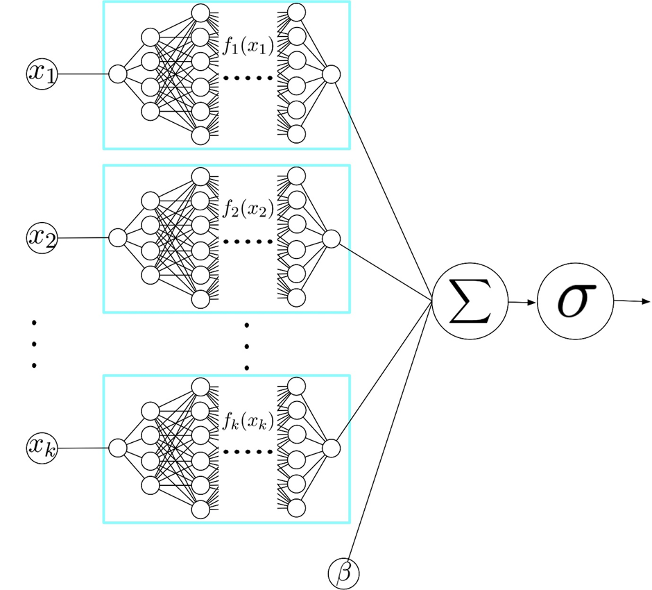
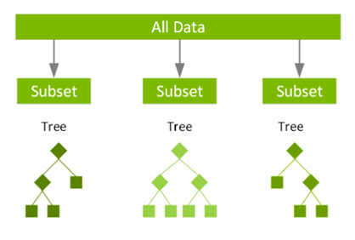
Machine – Deep Learning Model
XGBoost
ANN
DNN
NAM
Extreme Gradient Boosting
Artificial Neural Network
Deep Neural Network
Neural Addictive Network

Slide 14
Level of Complexity
XGBoost – Machine Learning
ANN – Deep Learning – One Hidden Layer
DNN – Deep Learning – Two or more Hidden Layer
NAM – Deep Learning – Two ore more DNN

Slide 15

Machine Learning
Use of data and algorithms to enable machines to learn and improve their performance on a set of tasks
Notes:
focuses on developing algorithms and models that allow computers to learn and make predictions or decisions without being explicitly programmed. It involves training algorithms on large amounts of data to recognize patterns, extract insights, and make accurate predictions or classifications. Here are some key points about machine learning:

Slide 16
Deep Learning
A subfield of machine learning & learning complex patterns and relationships within data
Notes:
Deep learning is a subfield of machine learning that focuses on training artificial neural networks with multiple layers, known as deep neural networks (DNNs). Deep learning algorithms are designed to automatically learn and represent complex patterns and relationships in data by leveraging hierarchical representations.

Slide 17
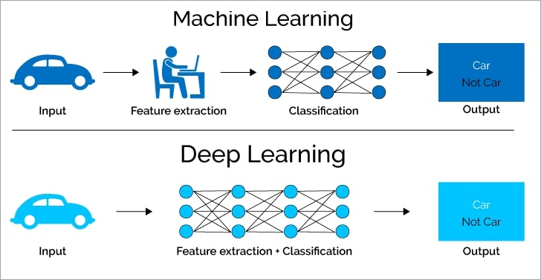
Compare Machine – Deep Learning
Notes:
The Deep Learning algorithm doesn't need a software engineer to identify features but is capable of automatic feature engineering through its neural network.

Slide 18

About Dataset
Analysis of the 2013 Big Mart sales data
Contains 8523 products from different regions and cities
Preprocess the dataset and split it into two parts: training and testing (8:2)

Slide 19
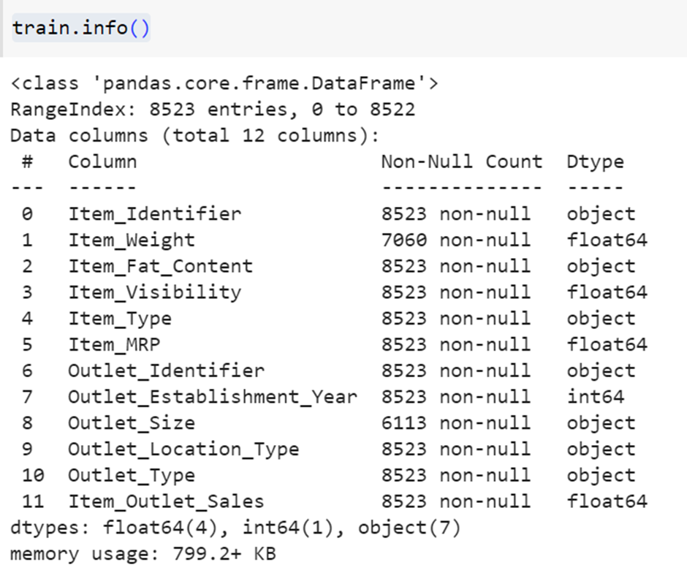

Slide 20
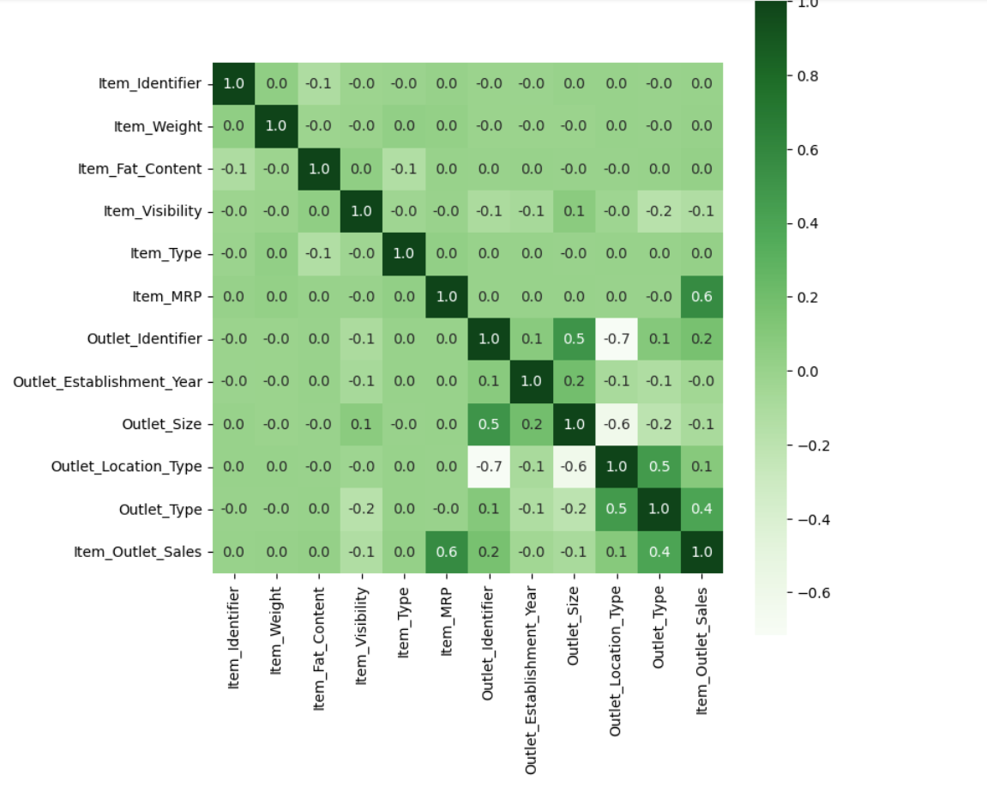
Notes:
Look at this heatmap, you can see, There isn't much correlation between the variables, except that if Item_MRP increases, Item_Outlet_Sales increases.

Slide 21
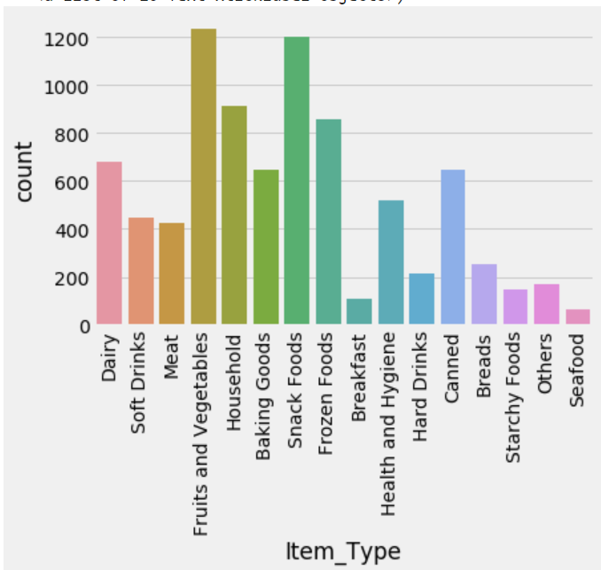
Notes:
From the illustration above, we can tell items like fruits and vegetables, household goods, snacks, starchy foods and seafood (From are more sold than the other items so the mall should consider keeping more of these items in inventory, give special offers and discounts to these goods so volume of sales increases more

Slide 22
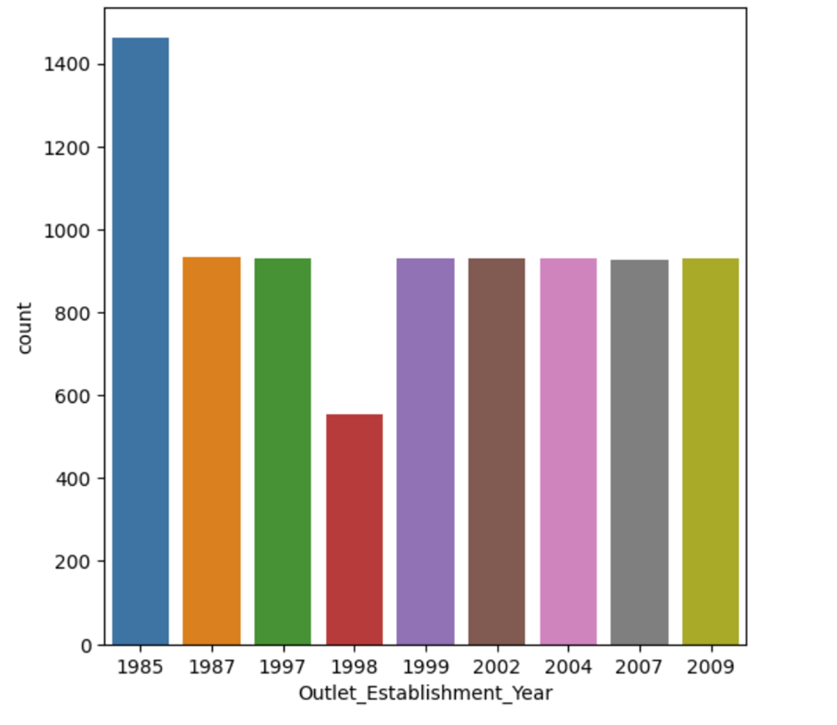
Notes:
In 1985, the debut year of the mall had the highest sales but from then on, sales volume was pretty much constant.

Slide 23
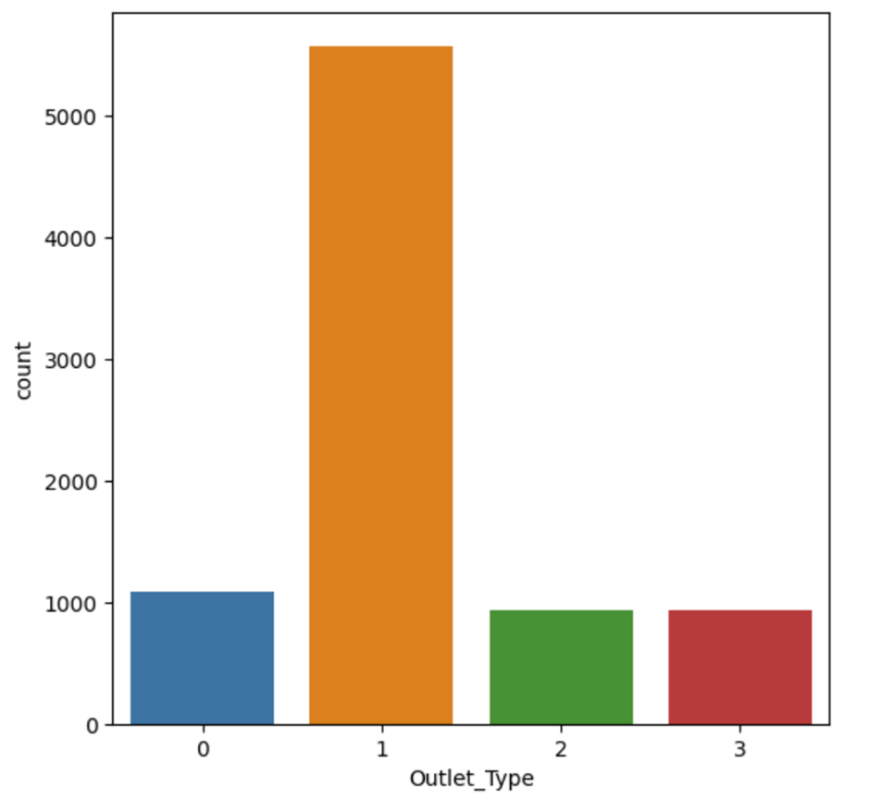
Notes:
Supermarket Type1 have the most sales, much higher than other types so the mall owners should consider building more of these types in other locations.

Slide 24
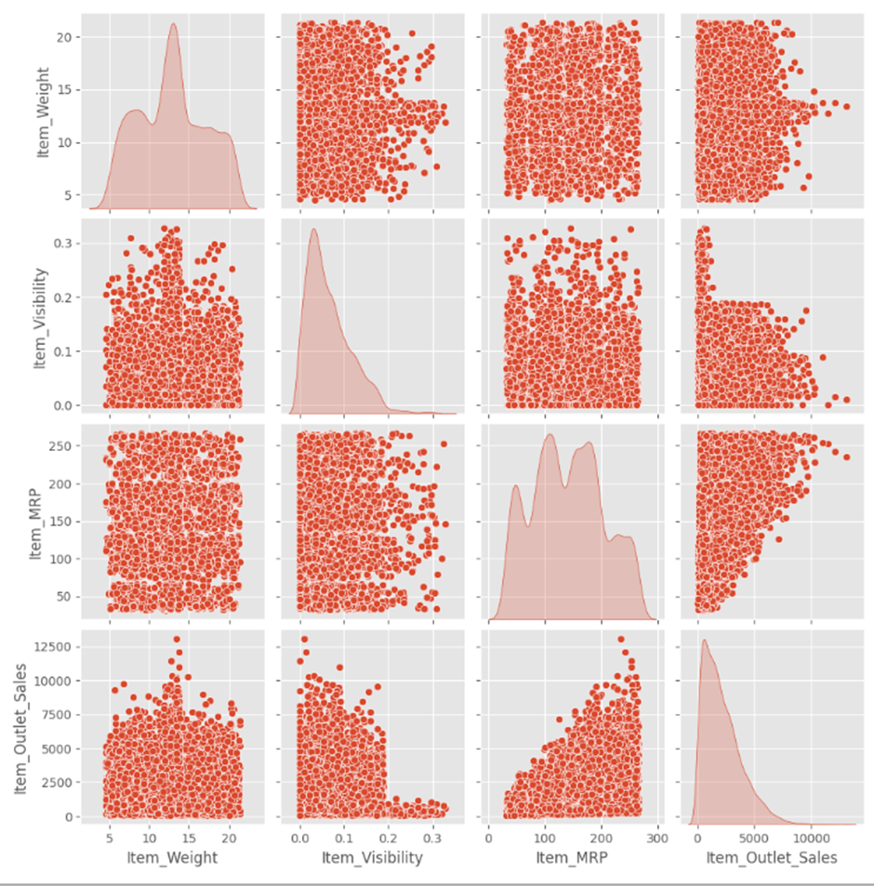
Notes:
Mostly all features have uniform distribution, seems no relation in particular
Sales of items having higher Item_Visibility > 0.2, Sales tend to be lower
Item_MRP and Item_Visibility might be good candidate for predicting Item_Outlet_Sales.

Slide 25

Embedding Layers
a type of hidden layer in a neural network that maps input information from a high-dimensional to a lower-dimensional space
allowing the network to learn more about the relationship between inputs and to process the data more efficiently

Slide 26
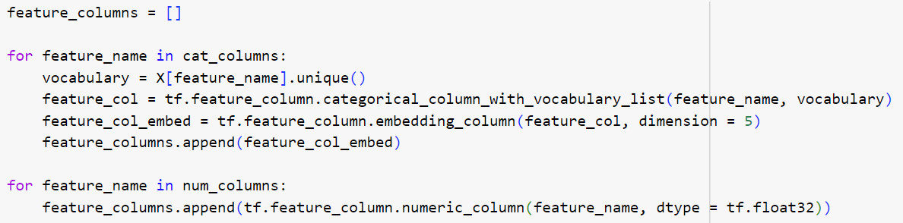
The dimension parameter in the embedding_column specifies the dimensionality of the embedding space. It means that each categorical feature will be mapped to a vector of dimensionality 5 in this case.

Slide 27
Rectified Linear Units (ReLU)
Be the most commonly used activation function
Returns 0 if it receives any negative input, but for any positive value x it returns that value back.

Slide 28
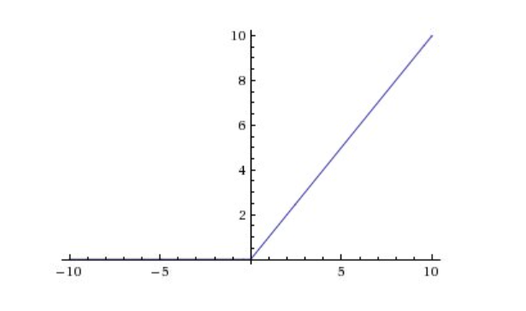
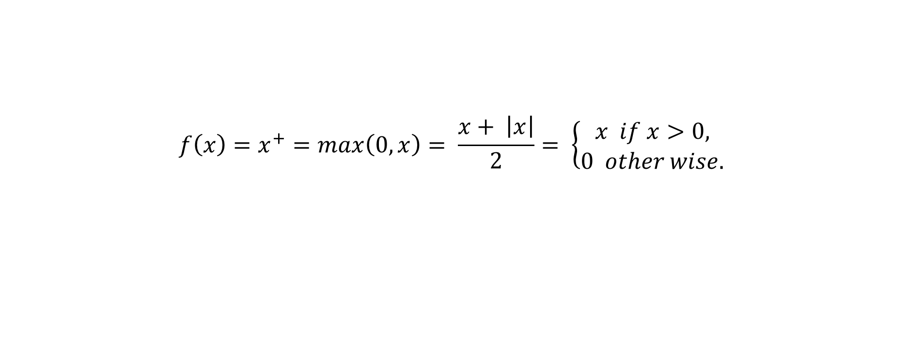
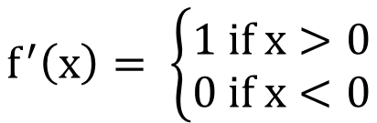
$$f\left(x\right)=x^{+}=\max\left(0,x\right)= \frac{x+ \left|x\right|}{2}= \left\{\begin{aligned}x if x>0, \\ 0 other wise.\end{aligned} \right.$$
$$f^{′}\left(x\right)= \left\{\begin{aligned}1 if x>0 \\ 0 if x<0\end{aligned}\right.$$

Slide 29
Advantages of ReLU
Computa-tional simplicity
Represen-tational sparsity
Linear behavior
Train deep networks
Use ReLU as the default activation function

Slide 30
Disadvantages of ReLU
Dying ReLU
Not zero-centered
Not suitable for RNNs
Arbitrary choice of derivative at zero
Non-differentiable at zero

Slide 31
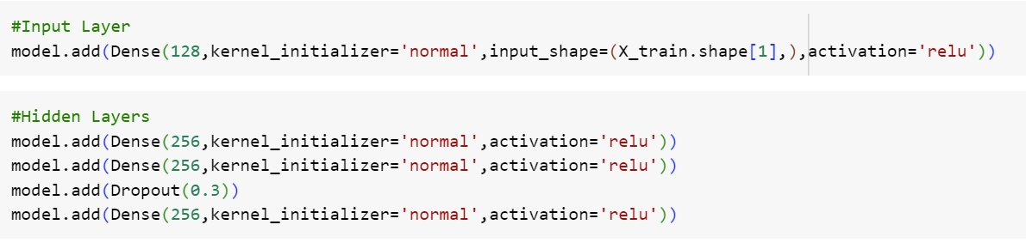
adds an input layer to the neural network model with 128 neurons, using the ReLU activation function
add multiple hidden layers to the neural network model, each with 256 neurons and ReLU activation

Slide 32
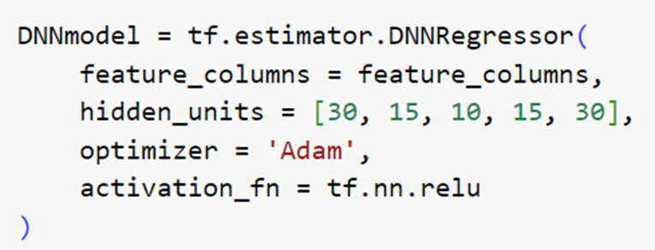
Adam
stands for Adaptive Moment Estimation.
combines the concepts of adaptive learning rates and momentum to efficiently update the model parameters during the training process.

Slide 33

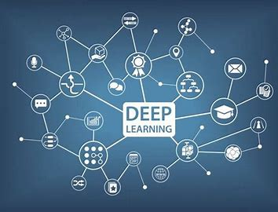
Machine Learning
Extreme Gradient Boosting (XGBoost)

Slide 34


Slide 35

XGBoost Model

Slide 36
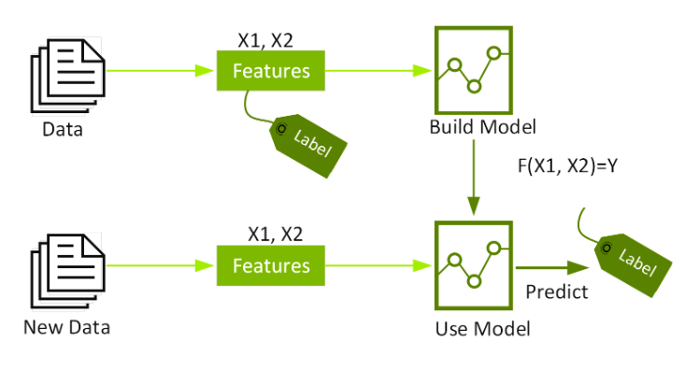
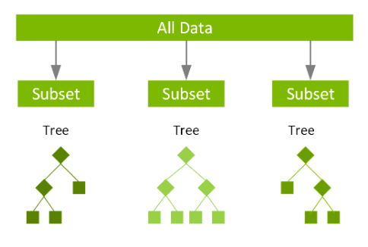
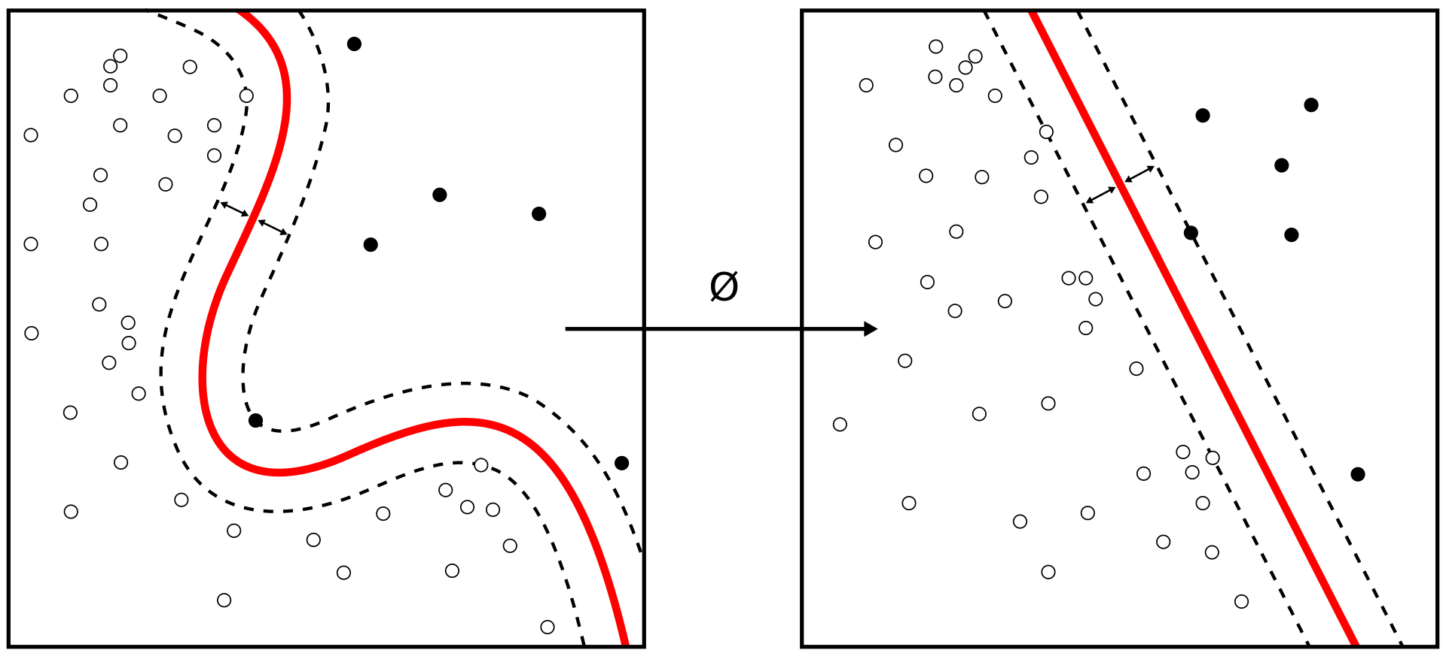
About XGBoost Model
XGBoost (Extreme Gradient Boosting) is a machine learning library that is widely used for regression, classification, and ranking problems
It is an optimized distributed gradient boosting library designed for efficient and scalable training of machine learning models
XGBoost is based on the concept of decision tree ensembles, where multiple weak models are combined to create a stronger prediction

Slide 37
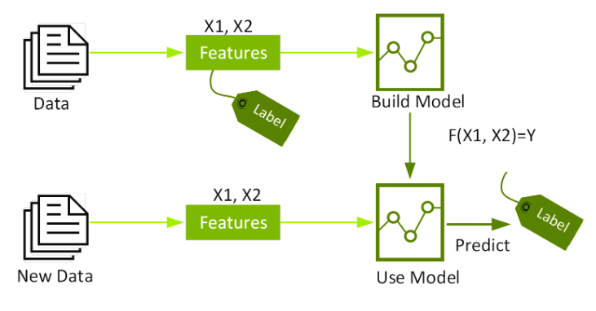
How it work?
Notes:
It’s vital to an understanding of XGBoost to first grasp the machine learning concepts and algorithms that XGBoost builds upon: supervised machine learning, decision trees, ensemble learning, and gradient boosting.
Supervised machine learning uses algorithms to train a model to find patterns in a dataset with labels and features and then uses the trained model to predict the labels on a new dataset’s features.

Slide 38
Assemble Algorithm
Ensemble learning combines several learners (models) to improve overall performance, increasing predictiveness and accuracy in machine learning and predictive modeling.

Slide 39
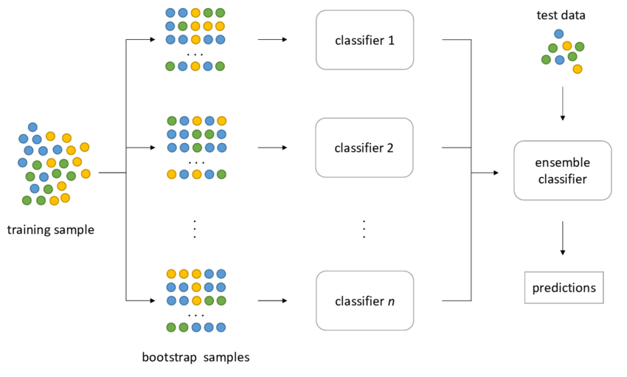
Bagging
The variance of the general model decreases significantly thanks to bagging
Notes:
Decrease overall variance by averaging the performance of multiple estimates. Aggregate several sampling subsets of the original dataset to train different learners chosen randomly with replacement, which conforms to the core idea of bootstrap aggregation. Bagging normally uses a voting mechanism for classification (Random Forest) and averaging for regression.

Slide 40
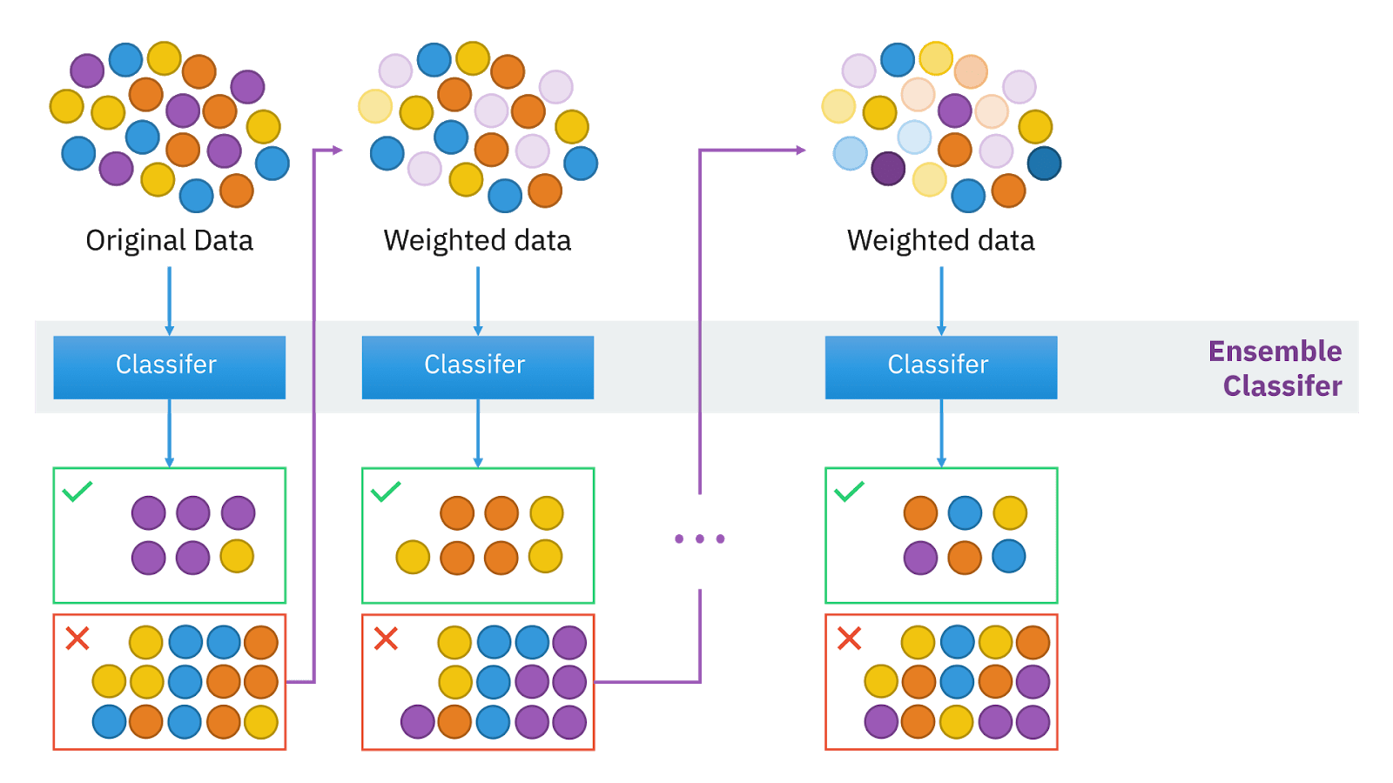
Boosting
The bias also decreases due to boosting
Notes:
This technique matches weak learners — learners that have poor predictive power and do slightly better than random guessing — to a specific weighted subset of the original dataset. Higher weights are given to subsets that were misclassified earlier.
Learner predictions are then combined with voting mechanisms in case of classification or weighted sum for regression.

Slide 41
Gradient Boosting
Gradient Boosting uses differentiable function losses from the weak learners to generalize. At each boosting stage, the learners are used to minimize the loss function given the current model.

Slide 42
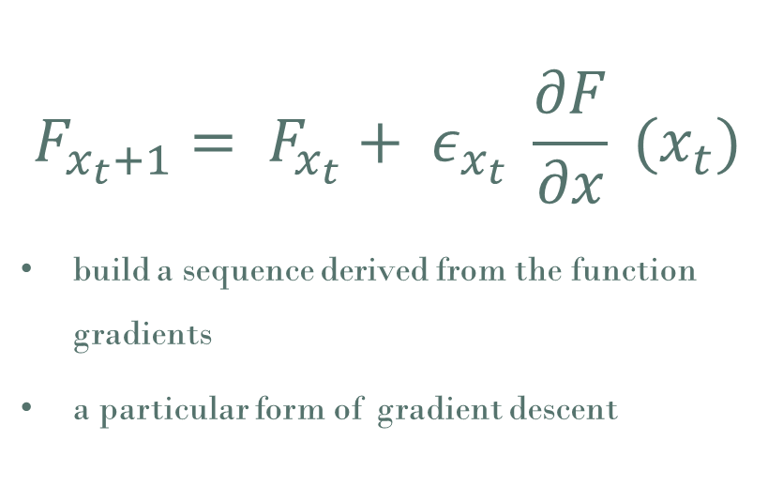
XGBoost Algorithm
$$F_{x_{t}+1}= F_{x_{t}}+ ε_{x_{t}} \frac{∂F}{∂x} (x_{t})$$
build a sequence derived from the function gradients
a particular form of gradient descent

Slide 43
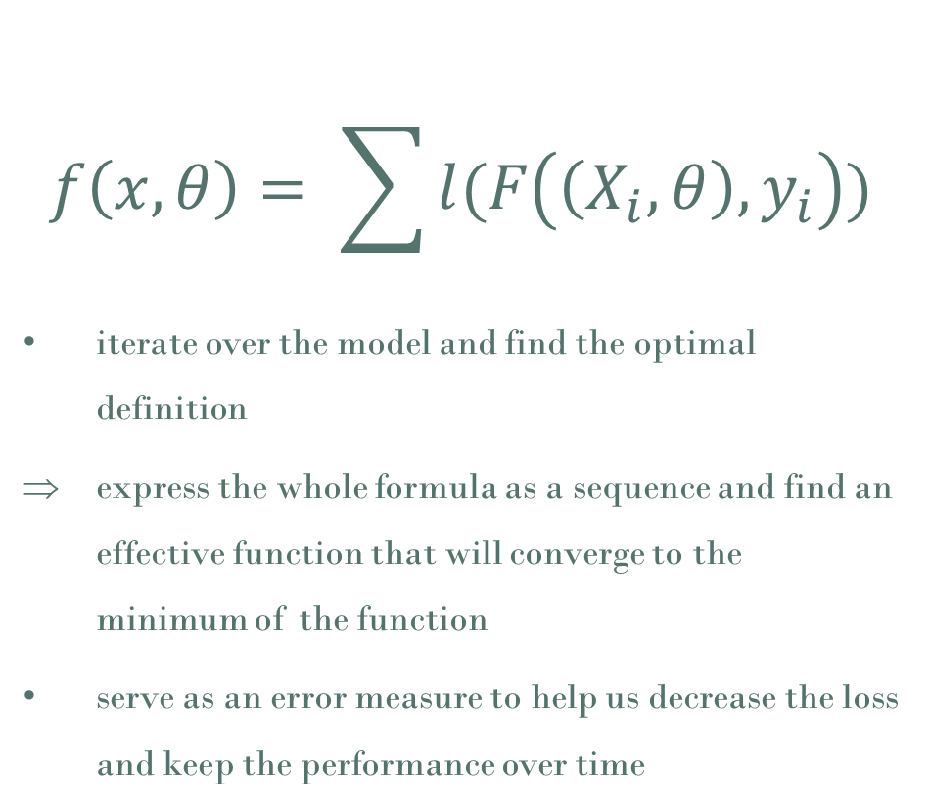
XGBoost Algorithm
$$f\left(x, θ\right)= \sum{l(F\left(\left(X_{i}, θ\right), y_{i}\right))}$$
iterate over the model and find the optimal definition
express the whole formula as a sequence and find an effective function that will converge to the minimum of the function
serve as an error measure to help us decrease the loss and keep the performance over time

Slide 44
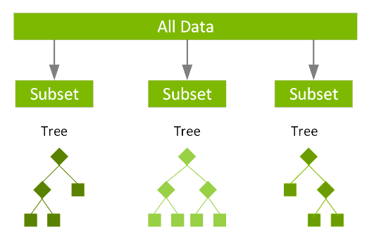
How it work?
Notes:
It’s vital to an understanding of XGBoost to first grasp the machine learning concepts and algorithms that XGBoost builds upon: supervised machine learning, decision trees, ensemble learning, and gradient boosting.
Supervised machine learning uses algorithms to train a model to find patterns in a dataset with labels and features and then uses the trained model to predict the labels on a new dataset’s features.

Slide 45
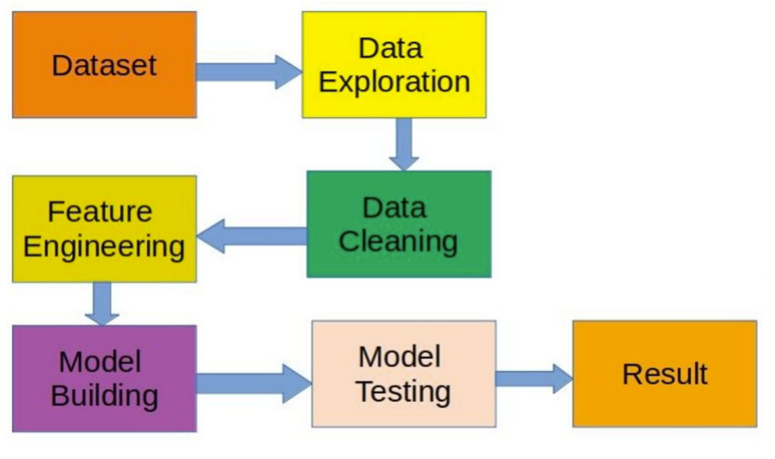
How it work?

Slide 46
Advantages of XGBoost
Performance
high performance and efficiency
handle large datasets and has optimized algorithms
improves the model's generalization capabilities
reduces the risk of overfitting on training data.
Flexibility
a wide range of loss functions and evaluation metrics
Feature Importance
Regularization
provides a feature importance score

Slide 47
Disadvantages of XGBoost
Complexity
complex to understand and implement
several hyperparameters that need to be tuned for optimal performance
Interpretability
ensemble nature of XGBoost & combination of multiple trees make it harder to interpret the individual decision-making process
Parameter Tuning

Slide 48
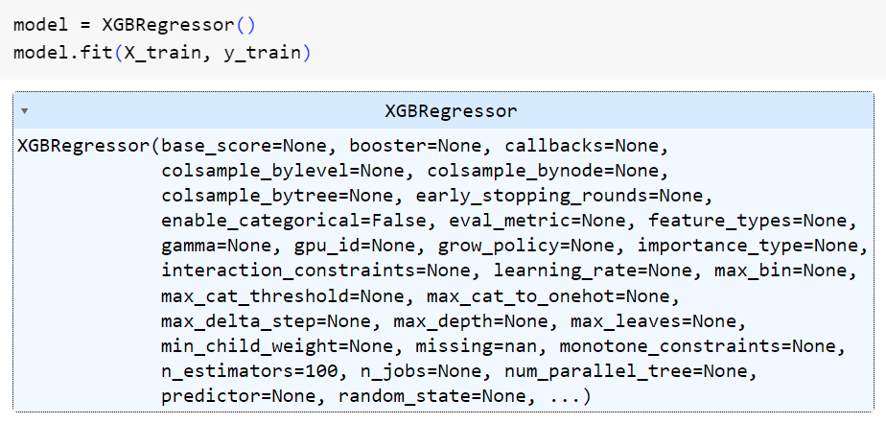

Slide 49

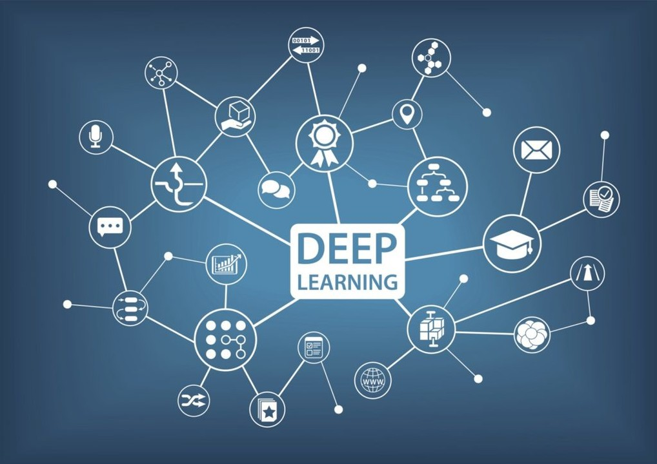
Deep Learning
Artificial Neural Network (ANN)
Deep Neural Network (DNN)
Neural Addictive Model (NAM)

Slide 50

Notes:
I am adam

Slide 51
ANN Model

Slide 52

Artificial Neural Network
Artificial Neural Network (ANN) is a computational model inspired by the structure and functioning of the biological neural networks in the human brain.

Slide 53
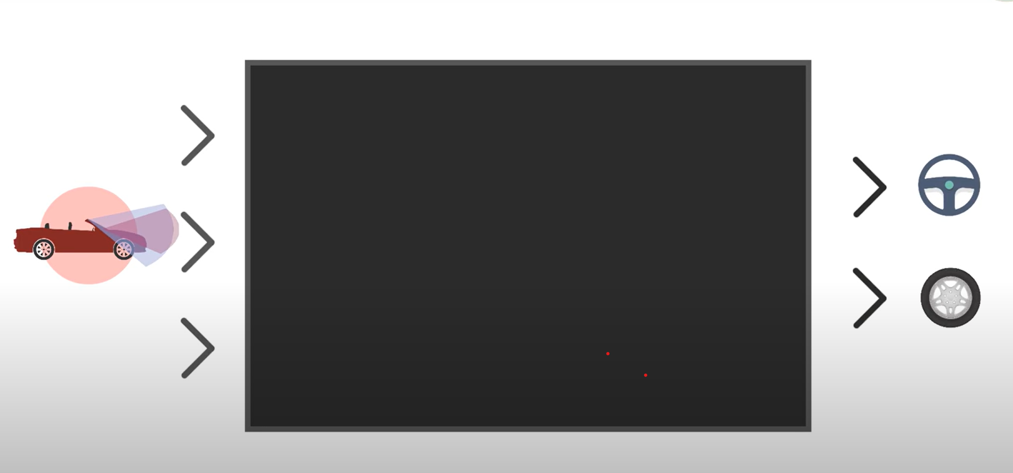
How it work?

Slide 54
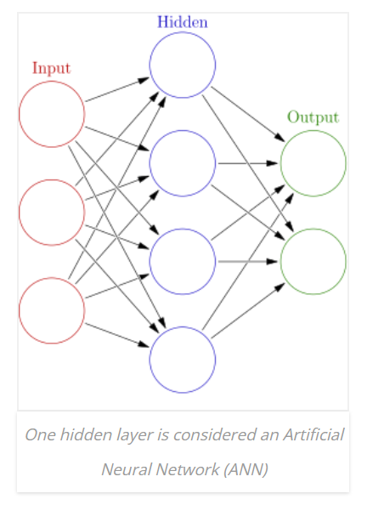
How it work?
Neural

Slide 55
How it work?
Layer

Slide 56
How it work?
Weighted Connections

Slide 57
How it work?
N
W

Slide 58
How it work?
0.53
3.14
0.14
-1.27

Slide 59
How it work?
0.53 X 3.14
1.58
0.53 X 3.14 + 0.14 x -1.27
BIAS
0.14 X -1.27

Slide 60
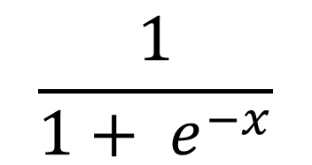
How it work?
Activation Function
1.58
$$\frac{1}{1+ e^{−x}}$$

Slide 61
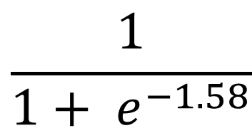
How it work?
Activation Function
$$\frac{1}{1+ e^{−1.58}}$$

Slide 62
How it work?
0.83

Slide 63
How it work?
Input
Output
Input
Input

Slide 64
Implementation of Artificial Neural Network
1) Data collection
2) Training and testing data separation
3) Select Network architecture
4) Parameter tuning and weight initialization
5) Data transformation
6) Training
7) Testing
8) Implementation

Slide 65
Advantages of ANN
Adaptability
automatically adjust their weights and connections based on the input data
allowing them to handle complex and non-linear relationships.
dentify and classify patterns in data
Fault Tolerance
robust against data noise and partial failures
Generalization
Pattern Recognition
generalize from the training data to make predictions on unseen data

Slide 66
Disadvantages of ANN
Black Box Nature
heir internal workings can be difficult to interpret
requires substantial computational resources, including processing power and memory,
Overfitting
Data Dependency
Computational Requirements
heavily rely on large amounts of labeled training data to learn effectively.
occurs when the network becomes too specialized

Slide 67
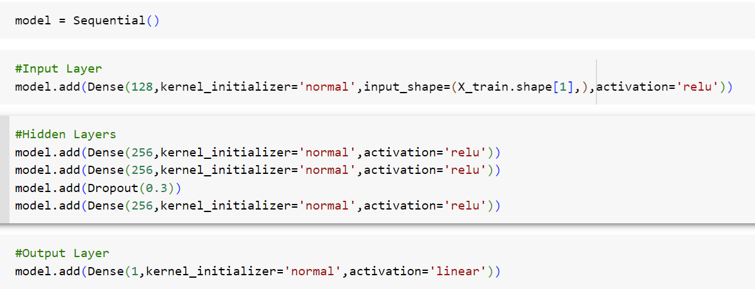
Define the Model

Slide 68
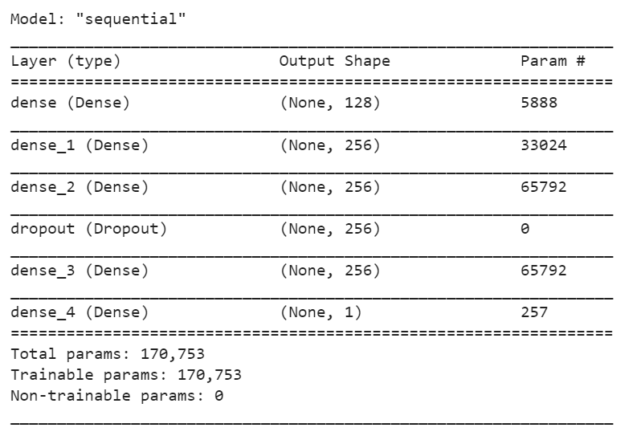
Define the Model

Slide 69
DNN Model

Slide 70
Deep Neural Network
Deep Neural Network model (DNN) a type of artificial neural network (ANN) that contains multiple hidden layers between the input and output layers

Slide 71
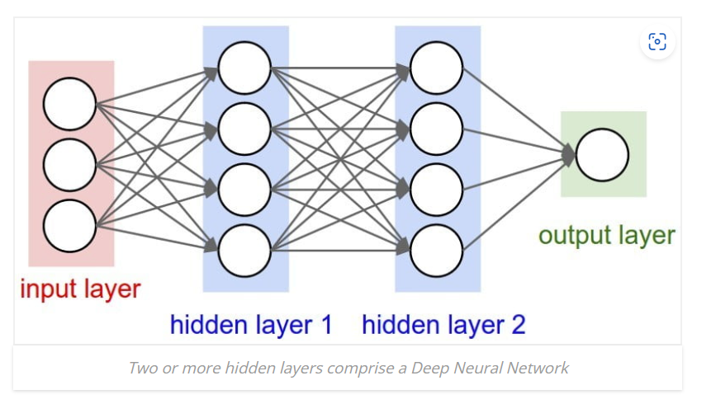
How it work?

Slide 72
Advantages of DNN
Increased Representation Power
capable of learning complex representations of data by leveraging multiple layers of interconnected nodes
automatically learn relevant features from raw or high-dimensional input data
State-of-the-Art Performance
Feature Learning
Transfer Learning
achieved remarkable performance in various domains
Leverage knowledge learned from one task to perform well on related tasks, a concept known as transfer learning

Slide 73
Disadvantages of DNN
Computational Complexity
Computational Complexity
require large amounts of labeled training data to generalize well and achieve high performance
Overfitting
Data Requirements
Interpretability
susceptible to overfitting, particularly when training data is limited or noisy
challenging to understand the inner workings and reasoning behind their predictions, resulting in reduced transparency

Slide 74
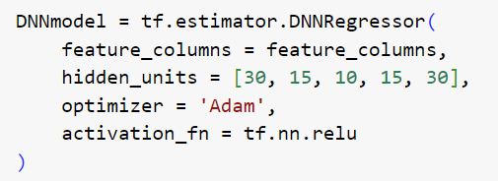
Define the Model
feature_columns: describe the data format and transformations to be applied to the input data.
hidden_units : a list of integers, where each integer represents the number of neurons in a particular hidden layer. In this code, the DNN has five hidden layers with 30, 15, 10, 15, and 30 neurons, respectively.
optimizer specifies : 'Adam' optimizer is used, which is a popular optimizer for gradient-based optimization algorithms.
activation_fn: ReLU (Rectified Linear Unit) activation function is used, which introduces non-linearity to the model.

Slide 75
NAM Model

Slide 76
Neural Addictive Network
Neural Addictive Network (NAN) is a type of deep learning model that combines the power of Deep Neural Networks (DNNs) with the concept of attention mechanisms.

Slide 77
How it work?
Input
Input
Output
Input

Slide 78
Advantages of ANN
Explainable
provide insight into how the model is making predictions and what features are most important
an expressive yet simple way to model complex relationships between variables
Parameter sparse
Expressive
remarkably parameter sparse, which can help to reduce overfitting and improve generalization performance

Slide 79
Disadvantages of ANN
Limited to additive models
an only model linear relationships between variables
solve regression problems and may not be suitable for other types of machine learning tasks
Computationally expensive
Limited to regression problems
computationally expensive to train, particularly for large datasets or complex models

Slide 80
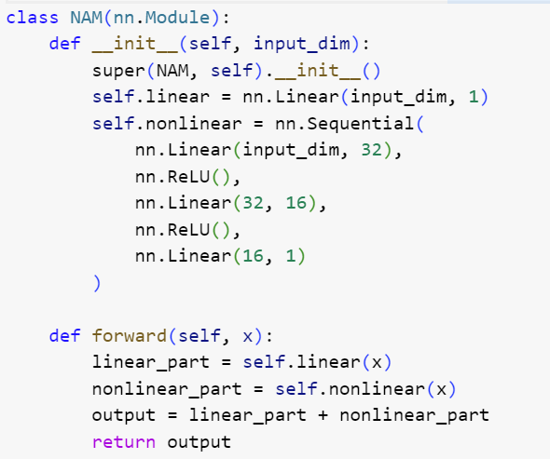
Define the Model
In the __init__ method: a linear part and a nonlinear part.
The linear part is defined using a single nn.Linear layer, which takes the input dimension input_dim and outputs a single value.
The nonlinear part allows for the sequential combination of multiple layers. It consists of three nn.Linear layers with ReLU activation functions in between.
forward method: takes an input x, which is passed through both the linear and nonlinear parts. The outputs of the linear and nonlinear parts are then added together to obtain the final output.

Slide 81
Table of Prediction Errors
 | R2 | MSE | RMSE | MAE | MDAE
XGBoost | 0.5191234777241828 | 1484501.750774029 | 1484501.750774029 | 856.8716943000217 | 576.9436505859376
ANN | 0.3381651964239938 | 0.01152943890524462 | 0.10737522482046136 | 0.07606321682762442 | 0.05088797999646821
DNN | 0.5922714589302618 | 1108193.9699328553 | 1108193.9699328553 | 750.2956788281107 | 529.0412925781252
NAM | 0.6111445468539286 | 1056897.4818917033 | 1028.0551939909176 | 728.6469746496747 | 502.82359101562497
Notes:
Hello word

Slide 82
THANKS FOR LISTENING

